Slide 1
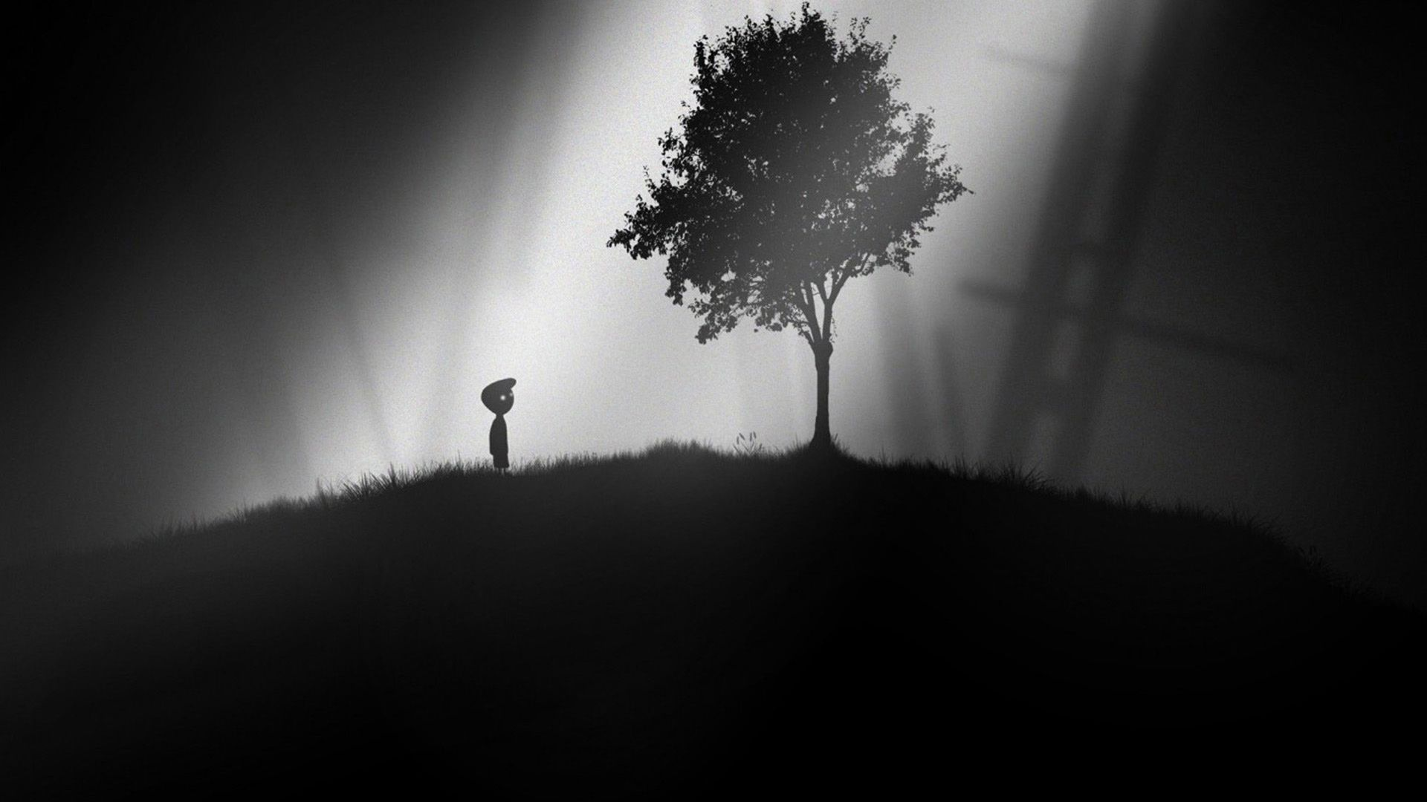
Near-death experience: The mind in extremis
Juan C. Sanchez-Arias, MD
PhD Candidate (Neuroscience)
University of Victoria
We acknowledge with respect the Lkwungen-speaking peoples on whose traditional territory the Royal BC Museum stands and the Songhees, Esquimalt peoples whose historical relationships with the land continue to this day.
Night Shift: After Life – October 27th, 2018. Royal BC Museum, Victoria, BC. Canada

Slide 2
Table of contents
Your brain is awesome! 3 facts why this is true
The mind in extremis
What is consciousness?
Near-death-experiences
The aftermath
Brain decomposition
Transcendence: Uploading the human brain?

Slide 3
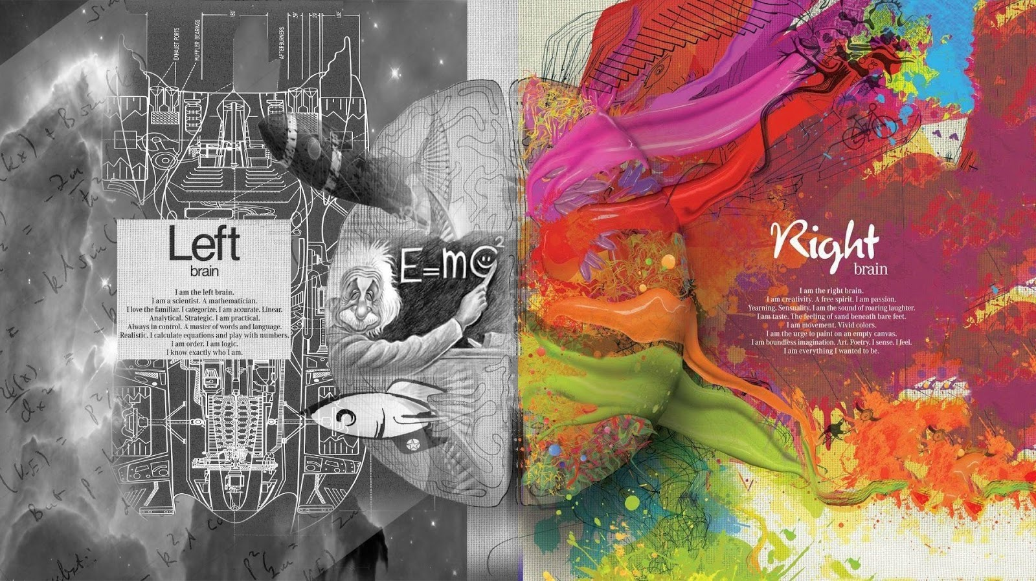
Your brain is awesome!

Slide 4
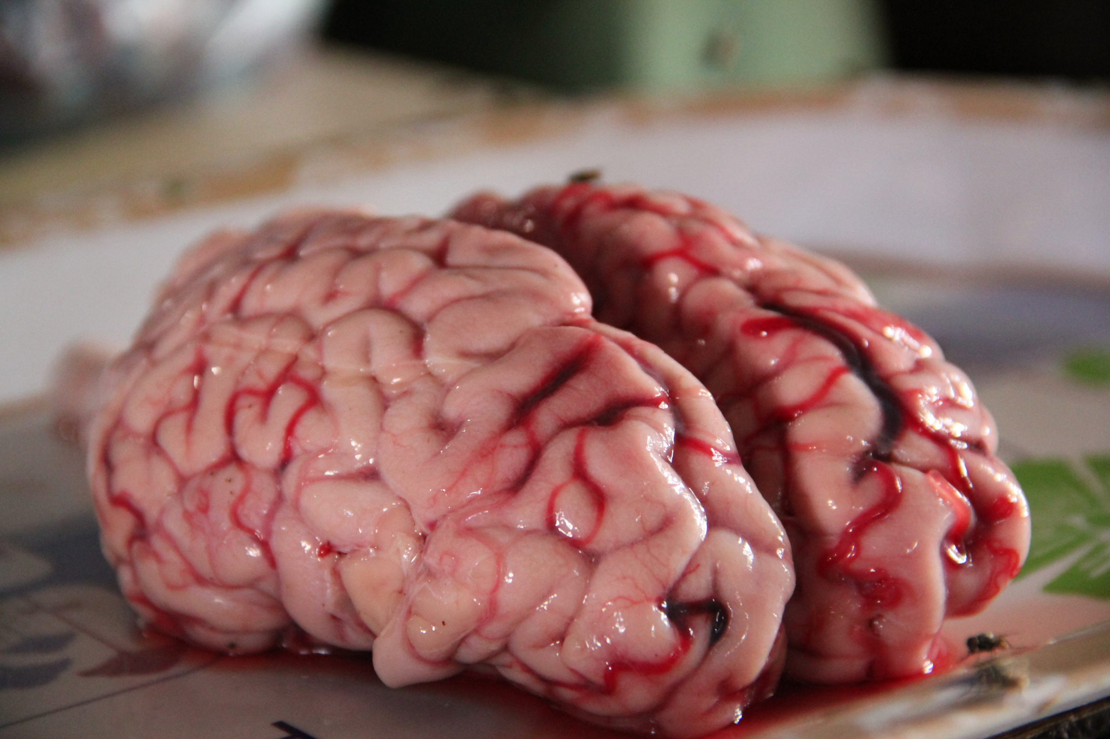


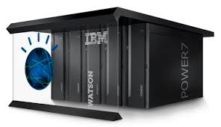
Fact #1: Energy
Only 2% of total body weight
But demands 20% of the resting metabolic rate.
With some math magic, that is (roughly):
12.6 watts -20 watts
Adeel Anwer. Flickr
60 watts
1,000 watts x 90
Jabr, F. Does Thinking Really Hard Burn More Calories?
Notes:
IBM's Watson, the supercomputer that defeated Jeopardy! champions, depends on ninety IBM Power 750 servers, each of which requires around one thousand watts.

Slide 5
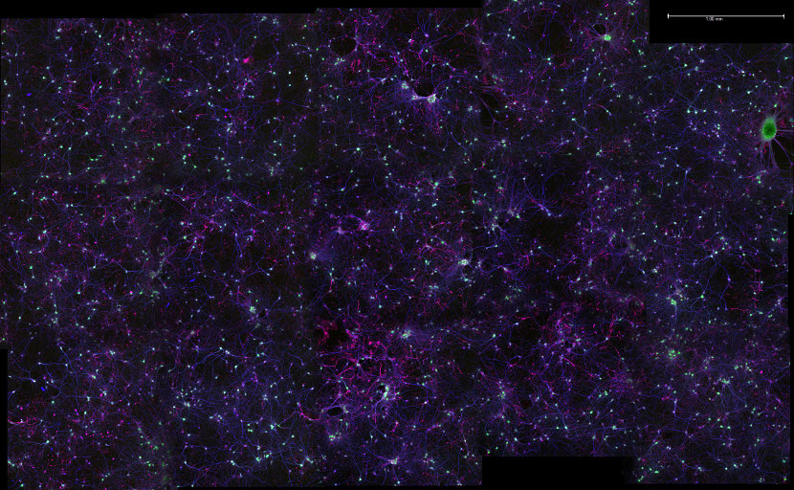

Fact #2: Galaxy
We have almost as many neurons as stars in the Milky Way!
200 – 300 billion stars
86.1 +/- 8.1 billion neurons
Want more?
Each neurons can have 7,000 synapses
> 100 trillion synapses!
Meaney Lab - UPenn
Are There Really as Many Neurons in the Human Brain as Stars in the Milky Way? | Brain Metrics | Learn Science at Scitable.
Azevedo, F.A.C., et al. (2009). Equal numbers of neuronal and nonneuronal cells make the human brain an isometrically scaled-up primate brain. J. Comp. Neurol. 513, 532–541.
Notes:
Each of the 10¹¹ (one hundred billion) neurons has on average 7,000 synaptic connections to other neurons. It has been estimated that the brain of a three-year-old child has about 10¹⁵ synapses (1 quadrillion)

Slide 6
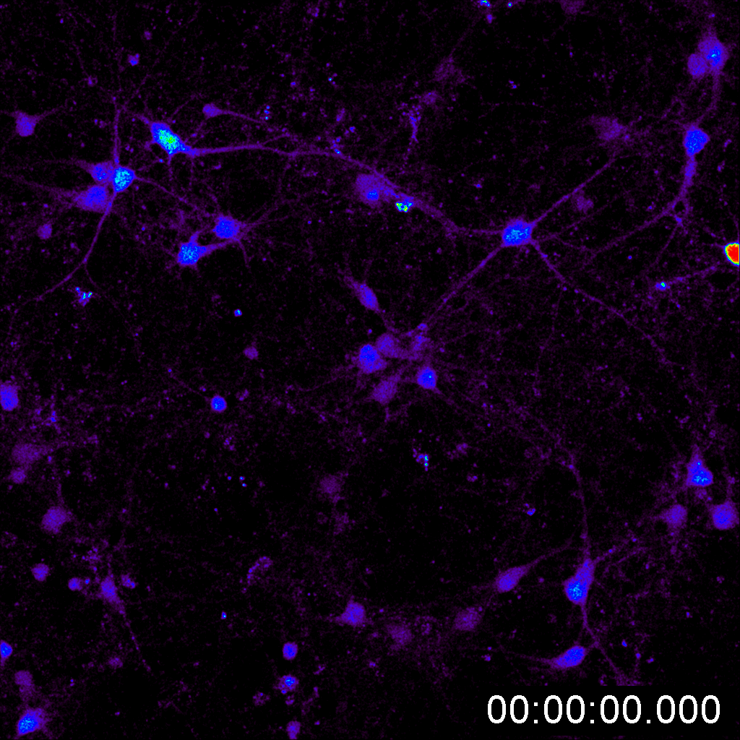
Fact #3: Plasticity
The brain is a river
Up to 70% of connections are re-organized every day
Functional plasticity
Moving a function to a different part
Structural plasticity
Changing physical structures from experience

Slide 7
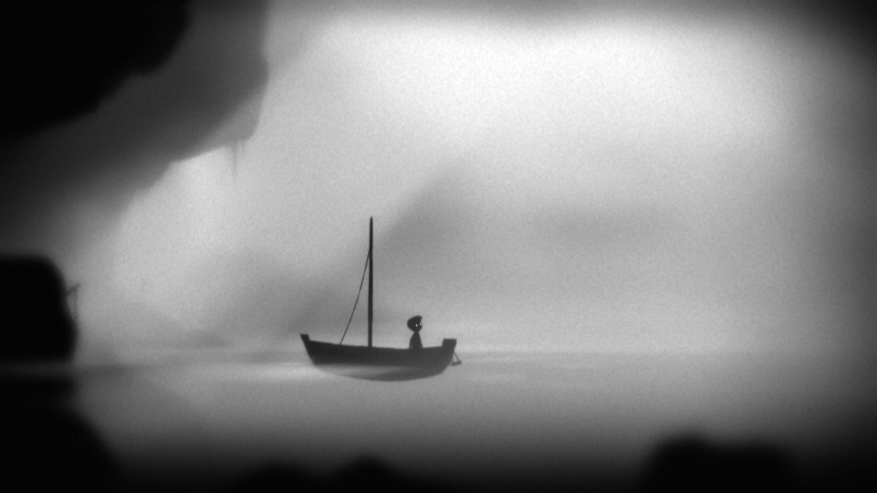
The mind in extremis (at the point of death)

Slide 8
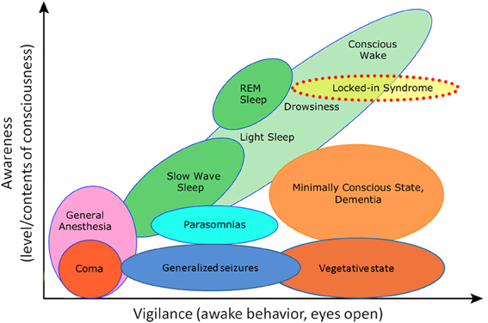
Mind, consciousness, levels?
Boly, M., et al. (2013). Consciousness in humans and non-human animals: recent advances and future directions. Front. Psychol. 4.

Slide 9
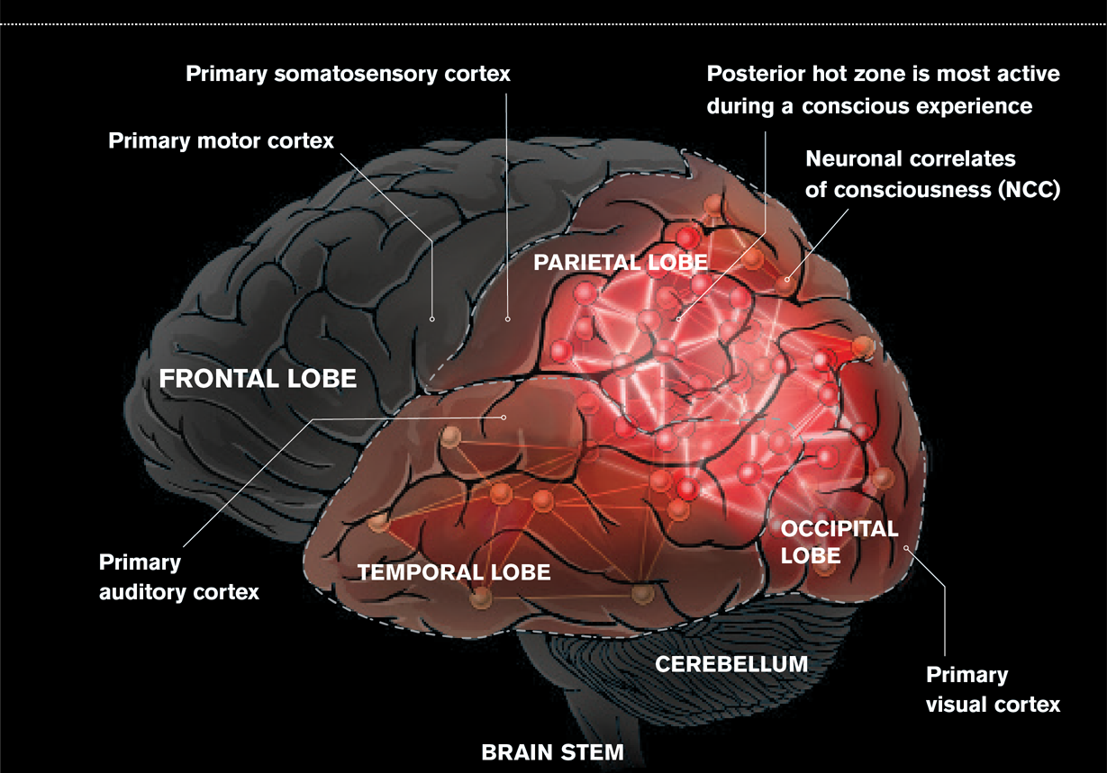
Koch, C. What Is Consciousness?

Slide 10
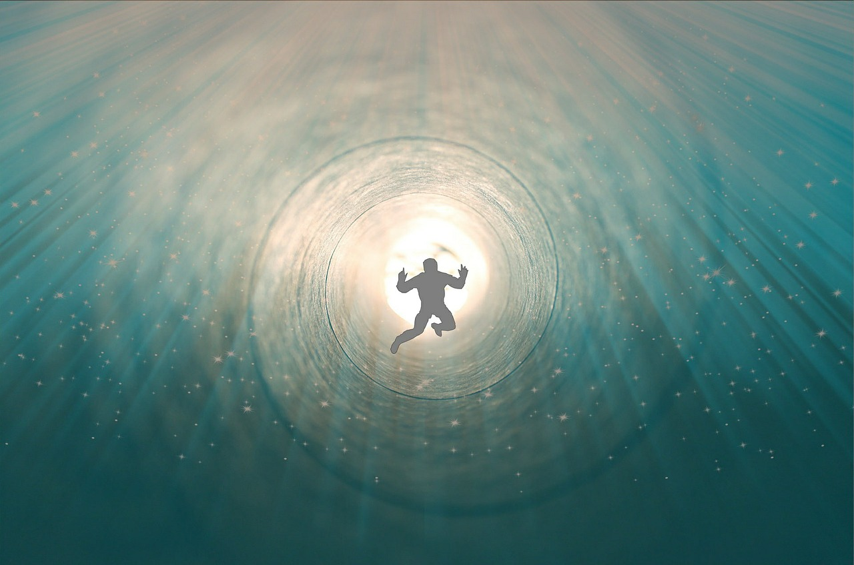
Near-death experiences
Personal experiences characterized by
Awareness of being dead (50%)
Positive emotions (56%)
Meeting with deceased persons (32%)
Moving through a tunnel (31%)
Celestial landscape (29%)
Out of body experience (24%)
van Lommel, P, et al. (2001). Near-death experience in survivors of cardiac arrest: a prospective study in the Netherlands. The Lancet 358, 2039–2045.

Slide 11
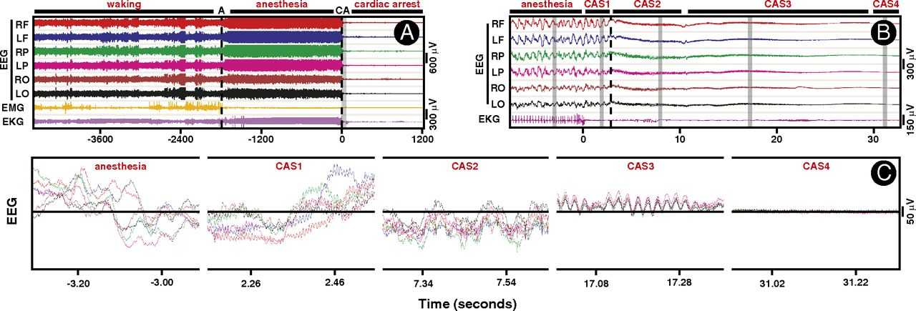
The brain in extremis

Slide 12
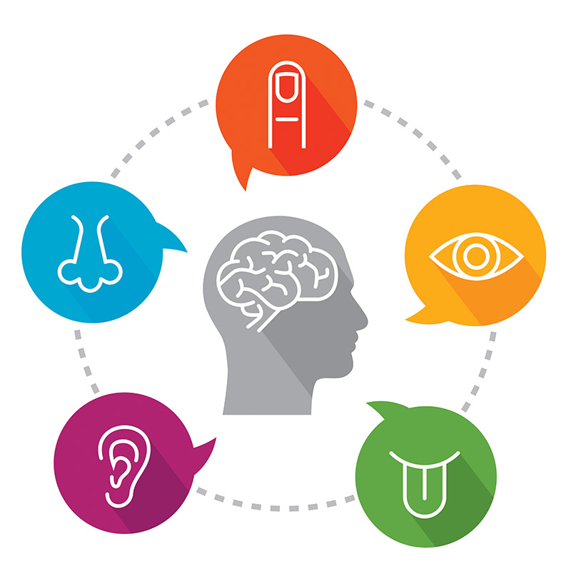
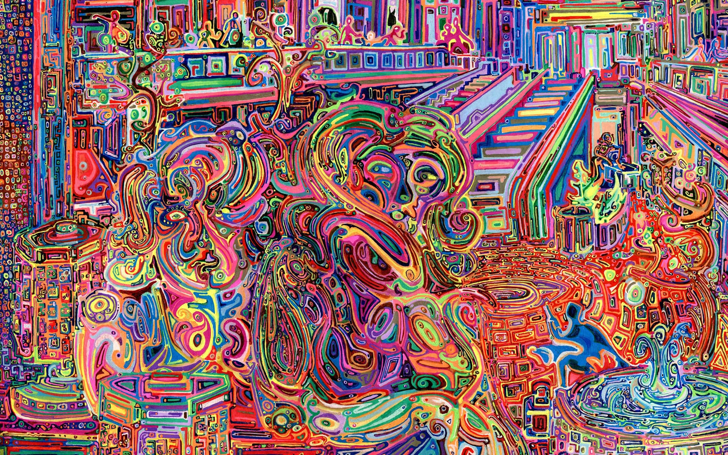
The brain in extremis

Slide 13
The aftermath

Slide 14
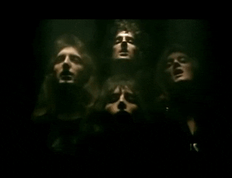
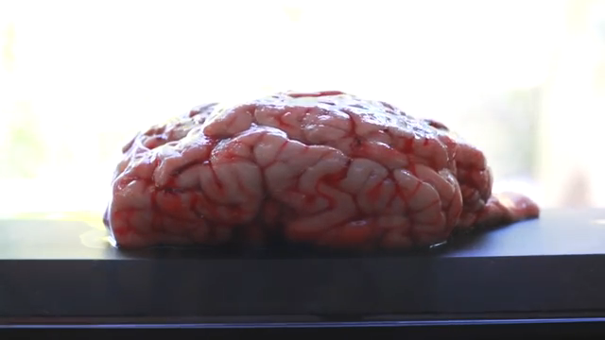
Brain decomposition
6 minutes
Autolysis
No oxygen, no cellular function
Release of enzymes
Accumulation of toxins
Putrefaction
Anaerobic degradation by intestinal bacteria
Decay
Aerobic destruction by other organisms

Slide 15
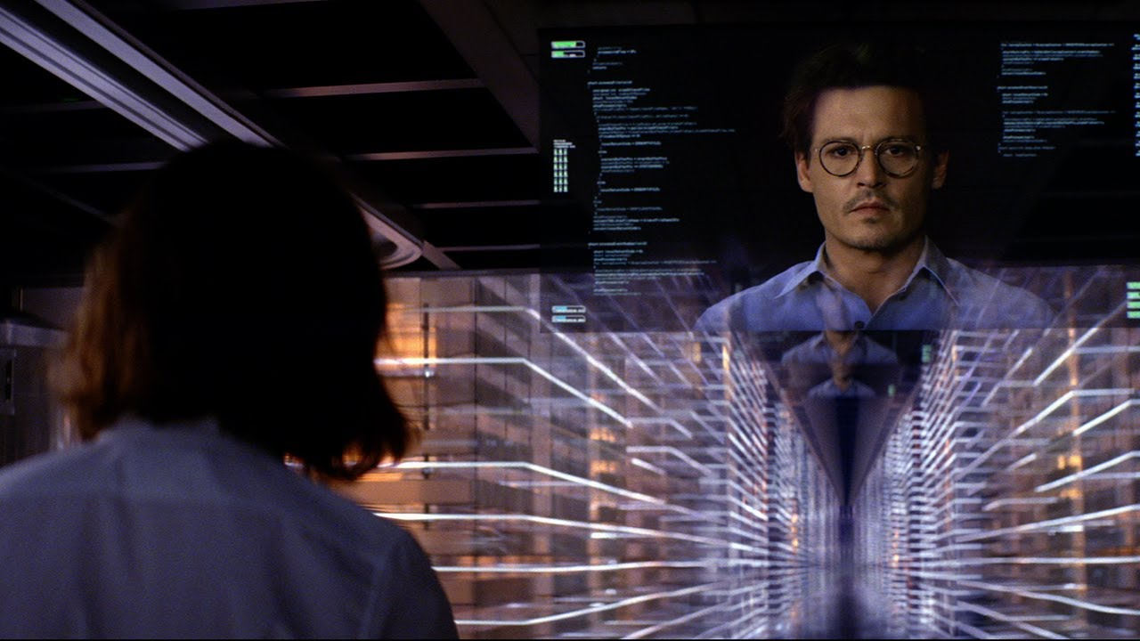
Uploading the human brain
How to make a copy of the human brain?
How to copy the human brain into a digital format?
How to read that code?

Slide 16
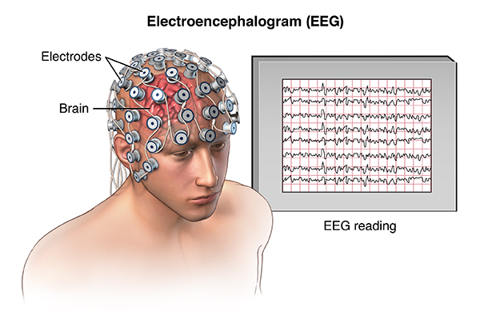
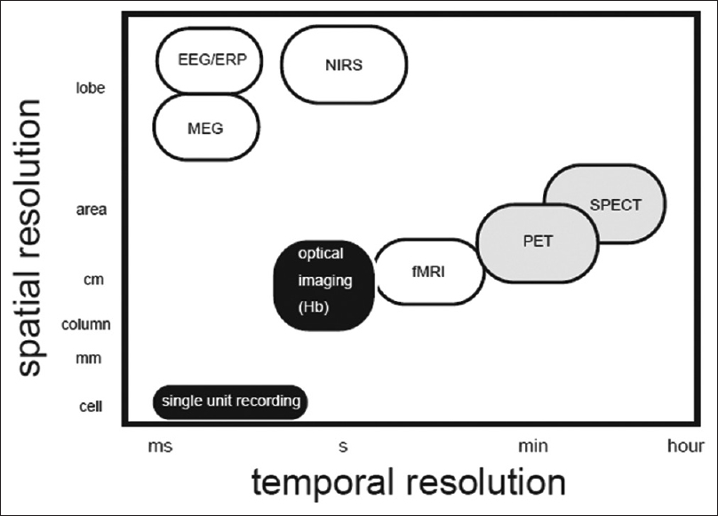
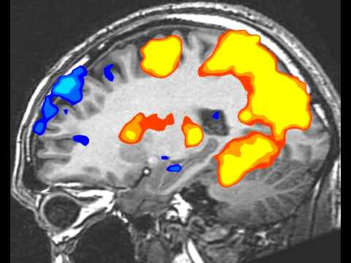
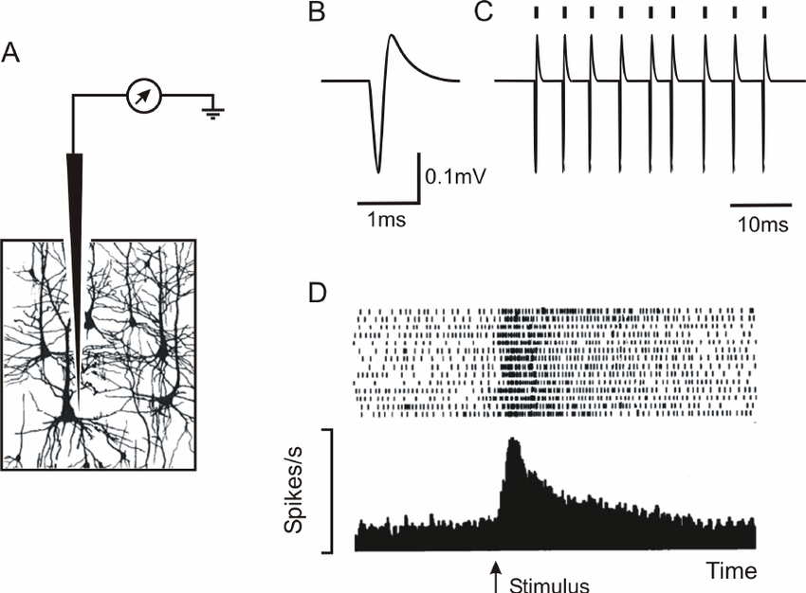
Reading the brain
Kameyama, M., Murakami, K., and Jinzaki, M. (2016). Comparison of [15O] H2O positron emission tomography and functional magnetic resonance imaging in activation studies. World Journal of Nuclear Medicine 15, 3.

Slide 17
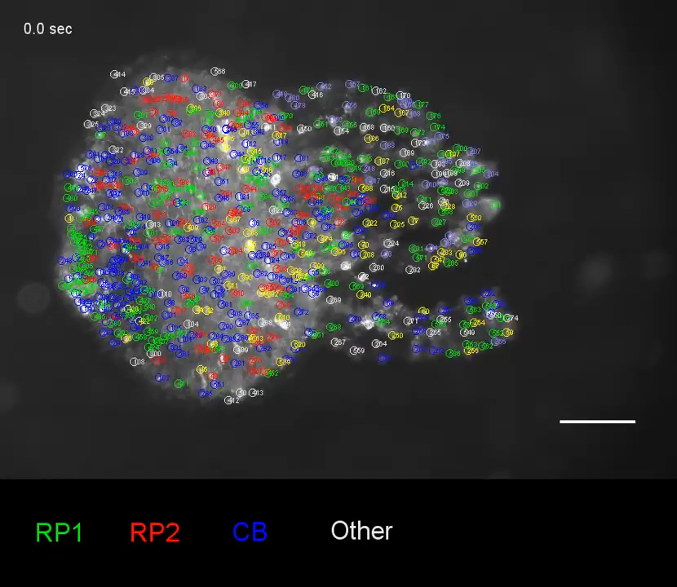
Not quite there but ...
This year the entire neuronal population of a hydra was recorded!
Using basic science researchers were able to track neuronal acitivty and behaviours at the same time

Slide 18
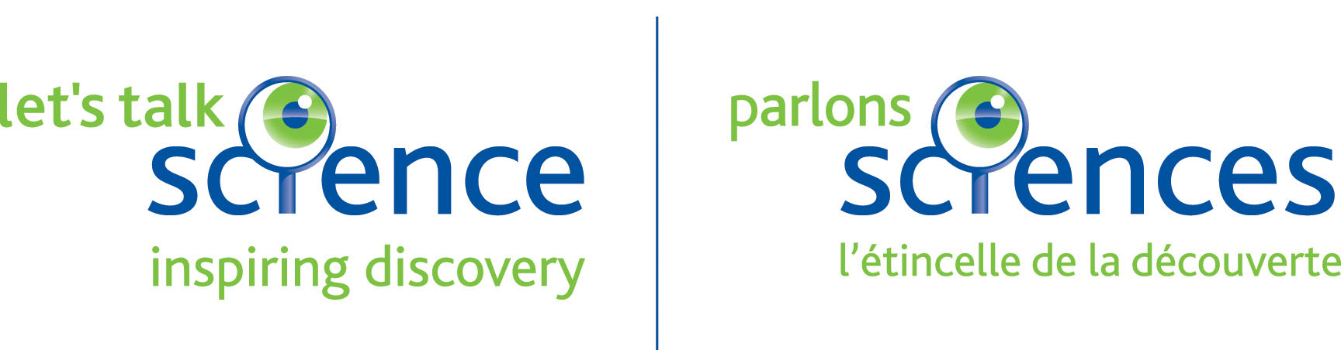
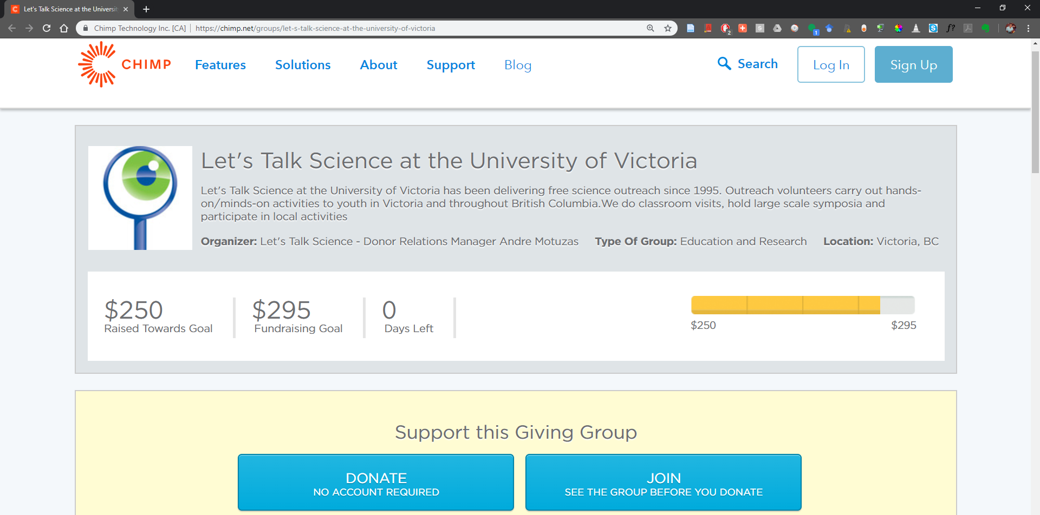

https://chimp.net/groups/let-s-talk-science-at-the-university-of-victoria
http://chim.pn/19FZKtk

Slide 19

Questions?

Slide 20
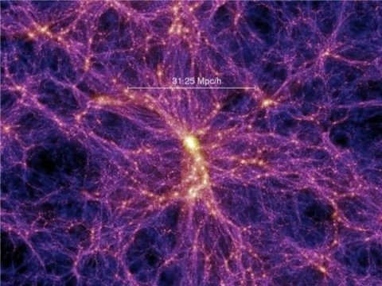
Mindblown
Cluster of galaxies
Neuronal network in culture

